Slide 1
University of Arizona Data Science Bootcamp
Group Project 1
Group Members:
Brenda Daly, Bryan Paynich, Anthony Mutwol, Frank Garcia

Slide 2
Objectives?
What is the Question we are attempting to Answer?
What is our hypothesis?
Brief background on superfund sites/cancer info
Display a gmap highlighting the superfund sites locations and display the total number of superfund sites. Talk about how many counties are there as well. Display the heat map and talk about the how it was extracted from a “coding
Talk about how we extracted data and also why some states the data could not be extracted.
What are the types of graphs or calculations that were applied. Primary emphasis on hypothesis testing. Display 6-8 visualizations. Include hypothesis testing. ( talk about preference in which test was selected)
Talk about potential solutions on reduction of cancer incidence. Was the hypothesis accepted or rejected?

Slide 3
What is the main research question?
Is there a higher incident of cancer in counties that contain a Superfund site?
Hypothesis: Due to the negative environment impact of superfund sites, the expectation is that cancer rates will be higher in the counties that contain Superfund site designations.

Slide 4
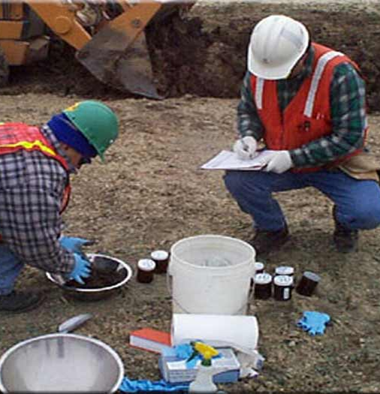
What is a superfund site?
A superfund site is a contaminated site that exists due to the fact that hazardous waste materials are dumped or left out in the open. This leads to the particular site been unmanaged.
The EPA came up with the SUPERFUND program to help clean the hazardous materials.
What are the goals of the SUPERFUND?
1: Protect human health and environment by cleaning up the contaminated sites.
2:Make responsible parties pay and clean up(lets be honest here too much bureaucracy).
3: Return superfund sites to productive use.

Slide 5

Cancer Types
The Cancer types that we are investigating are the following:
Lung Cancer.
Colon Cancer.
Breast Cancer
Prostate Cancer

Slide 6
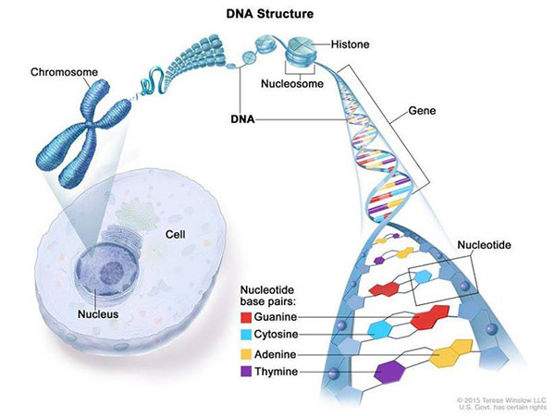
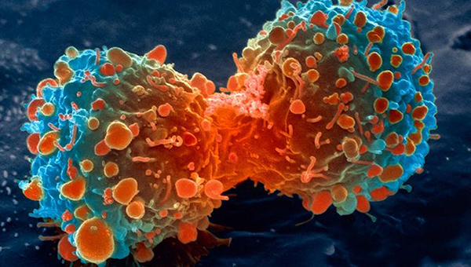
What are Cancers?
Cancer is a genetic disease that is caused by changes to genes that control the way a cell grows, function and how they divide.

Slide 7
Cancer Incidents
Cancer incidents rates is the number of new cancers of a specific site or type occurring in a specified population during a year and usually expressed the number of cancer per 100,00 at risk.
Here is the following equation below.
Incidents rate = (new cancers/population)X 100,000.
Age An age-adjusted rate is a weighted average of the age-specific rates, where the weights are the proportions of persons in the corresponding age groups of a standard population.
keep in mind that when calculating the incidents rate we do not include recurrences.

Slide 8
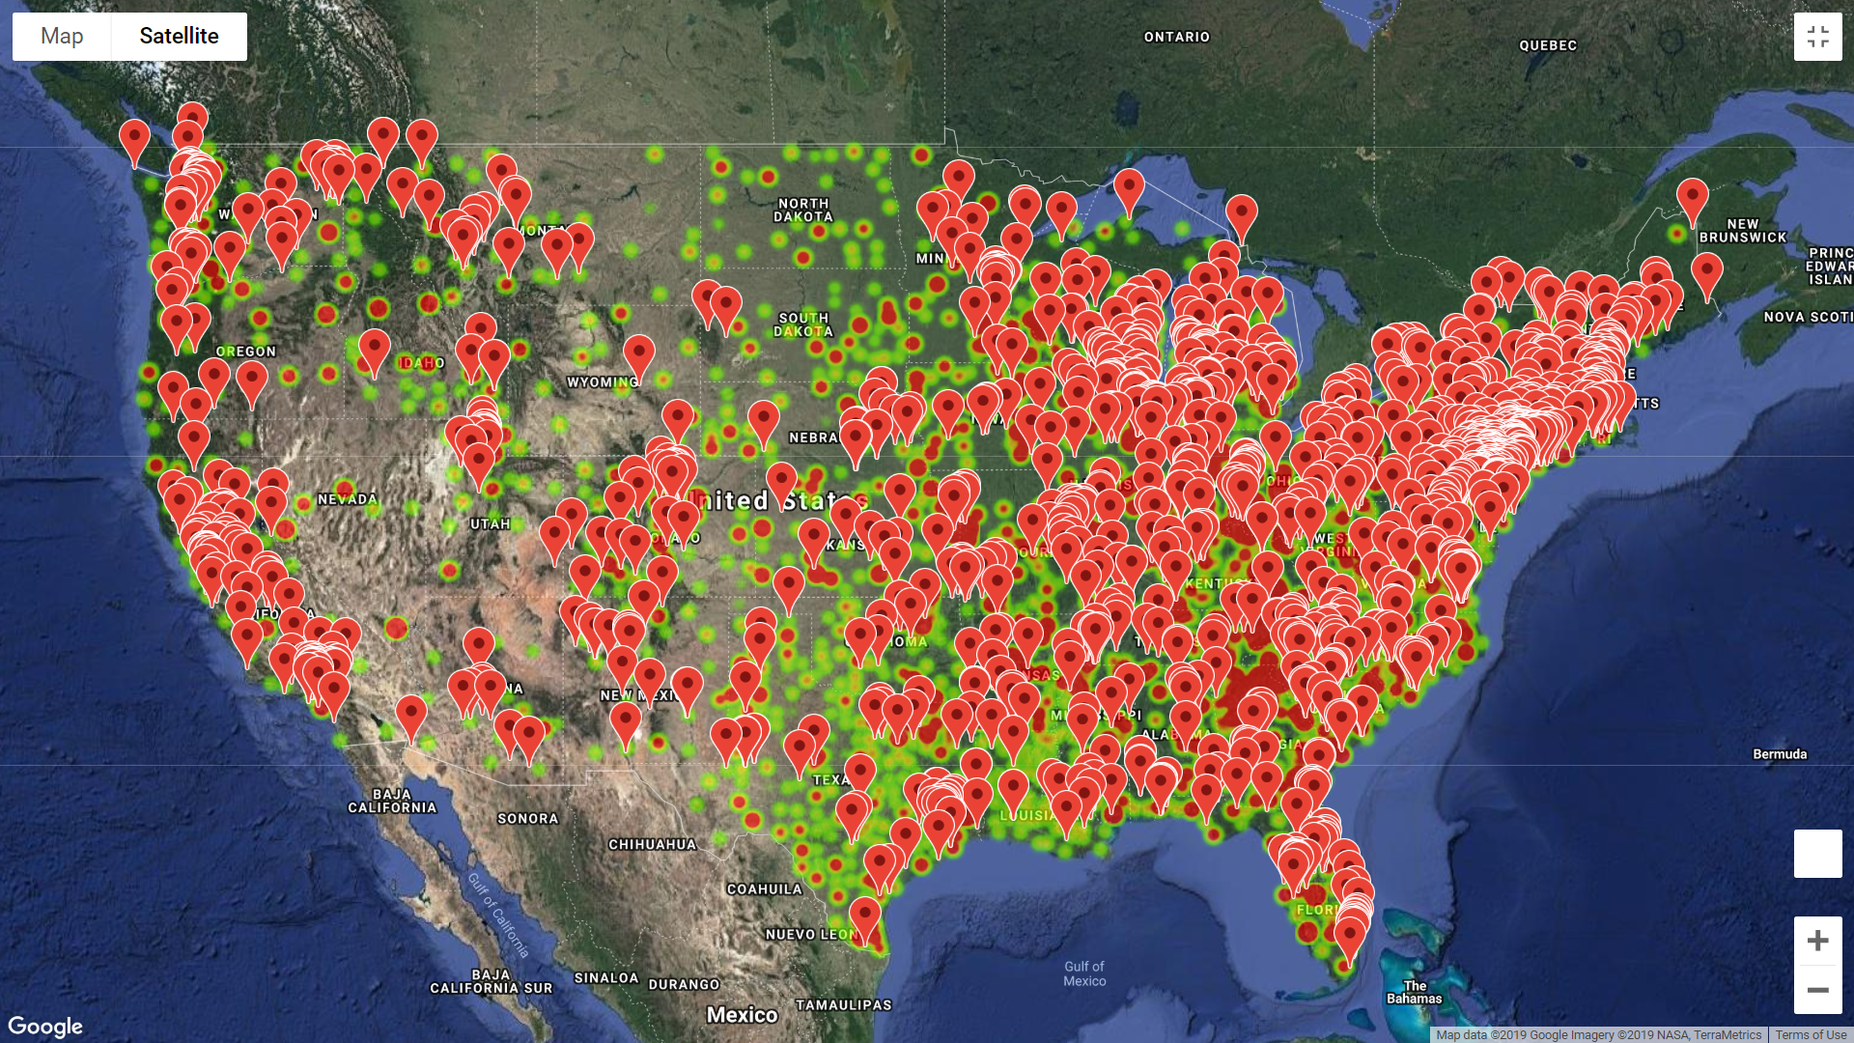
Data Visualization
The Image on your left displays a heat map of superfund sites locations nationwide.

Slide 9
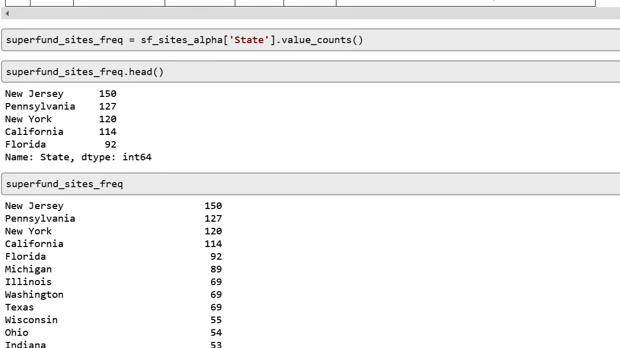
Superfund Count By State
Here is a representation of how many superfund sites were found in each state. With NJ having the most sites.

Slide 10
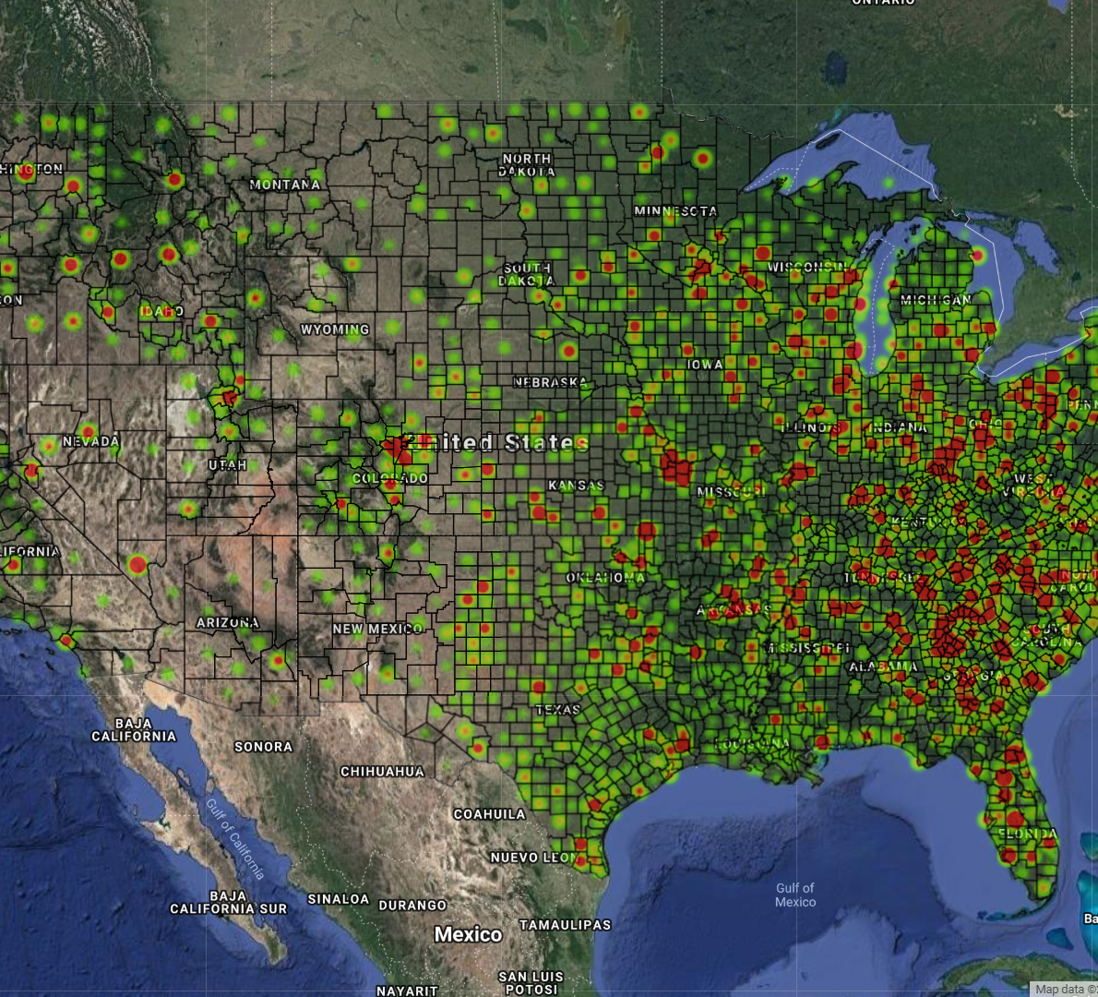
Breast Cancer
The Image on your right displays a heat map of breast cancer incidence. Cross referencing this heat map and the superfund sites heat map its very aggregated on the east side.

Slide 11
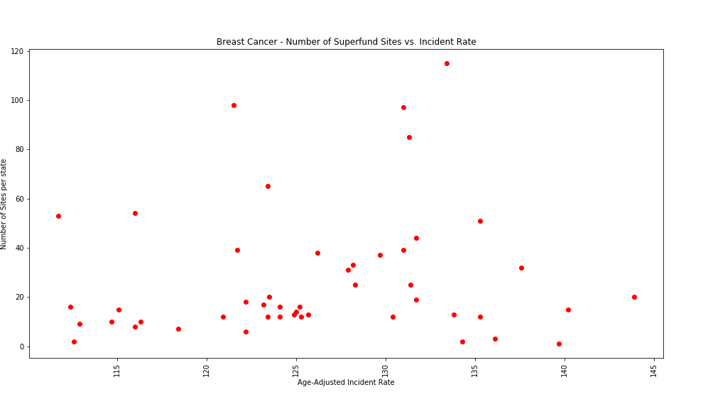
Data Visualization on Breast cancer
The Image on the left is a scatter plot representation of breast cancer in number of superfund sites vs incident rates. Take note on the X axis Age Adjusted incident rate.

Slide 12
More Data Visualization.

